Slide 1
Image Scraping and Classification Project
Aaron Dsouza

Slide 2
Agenda / Topics
Problem Definition
Data Analysis
EDA (Exploratory Data Analysis)
Pre-processing Pipeline
Building Machine Learning Models
Concluding Remarks

Slide 3
Problem Definition
Image classification has gained lot of attention due to its application in different computer vision tasks such as remote sensing, scene analysis, surveillance, object detection, and image retrieval.
The primary goal of image classification is to assign the class labels to images according to the image contents.
Images are one of the major sources of data in the field of data science and AI. This field is making appropriate use of information that can be gathered through images by examining its features and details.
The idea behind this project is to build a deep learning-based Image Classification model on images that will be scraped from e-commerce portal(Amazon.in). This is done to make the model more and more robust.

Slide 4
Data Analysis
Image classification and analysis is an active research area and there are many applications of automatic image classification in computer vision domains such as pattern recognition, image retrieval, object recognition, remote sensing, face recognition, textile image analysis, automatic disease detection, geographic mapping, and video processing.
In any image classification-based model, the primary objective of research is to assign the class labels to images.

Slide 5
Data Analysis
Image classification came into existence for decreasing the gap between the computer vision and human vision by training the computer with the data.
The image classification is achieved by differentiating the image into the prescribed category based on the content of the vision.
The conventional methods used for image classifying is part and piece of the field of artificial intelligence (AI) formally called as machine learning.
The machine learning consists of feature extraction module that extracts the important features such as edges, textures etc. And a classification module that classify based on the features extracted.

Slide 6
Data Analysis
The main limitation of machine learning is, while separating, it can only extract certain set of features on images and unable to extract differentiating features from the training set of data. This disadvantage is rectified by using the deep learning. Deep learning (DL) is a sub field to the machine learning, capable of learning through its own method of computing.
A deep learning model is introduced to persistently break down information with a homogeneous structure like how a human would make determinations. To accomplish this, deep learning utilizes a layered structure of several algorithms expressed as an artificial neural system (ANN).

Slide 7
Data Analysis
As an aspiring Data Scientist the goal is to apply my analytical skills to give findings and conclusions in detailed data analysis written in jupyter notebook.
The main goal of the project is to scrap image data namely three categories (Sarees (women) , Trousers (men), Jeans (men)) from Amazon.com. This data will be provided as an input to our deep learning model.

Slide 8
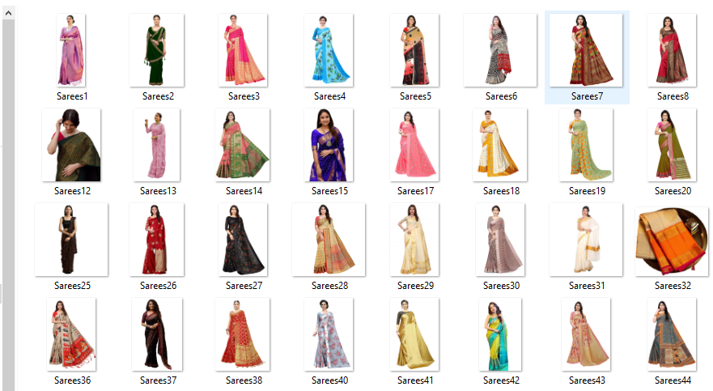
Data Analysis
Sarees sample Images

Slide 9
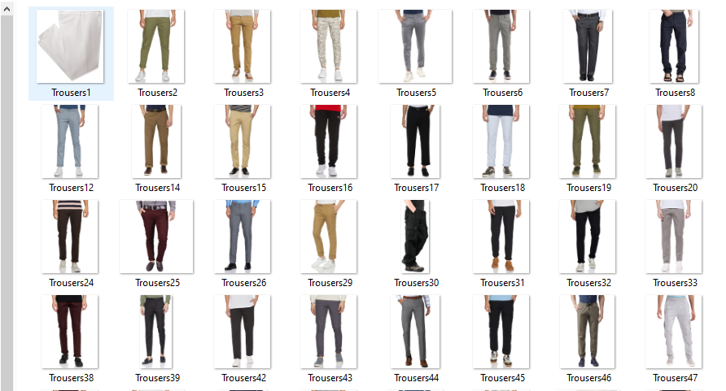
Data Analysis
Trousers sample Images

Slide 10
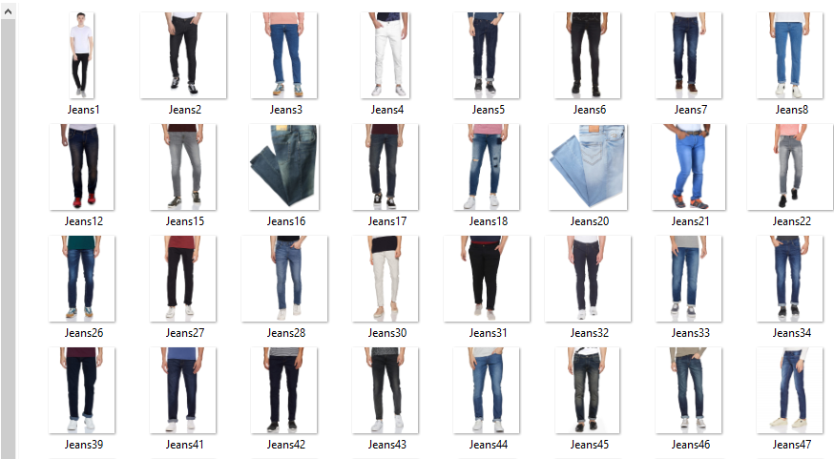
Data Analysis
Jeans sample Images

Slide 11
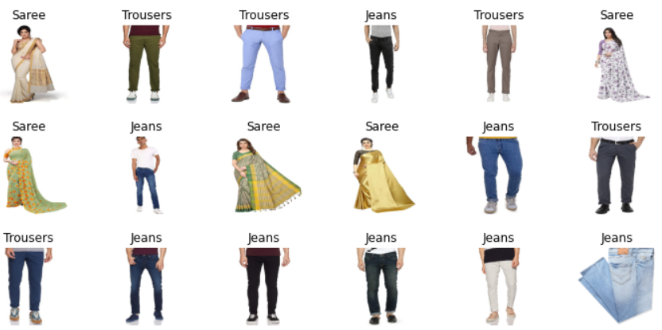
EDA (Exploratory Data Analysis)
Sample Data for classification

Slide 12
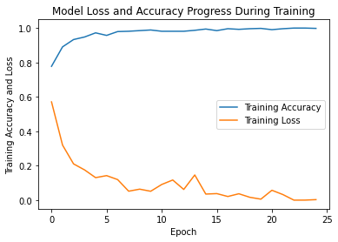
EDA (Exploratory Data Analysis)
Epoch Vs Accuracy

Slide 13
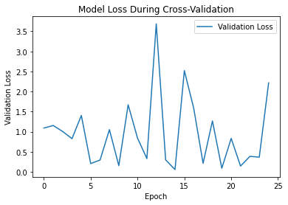
EDA (Exploratory Data Analysis)
Epoch Vs Validation Loss

Slide 14
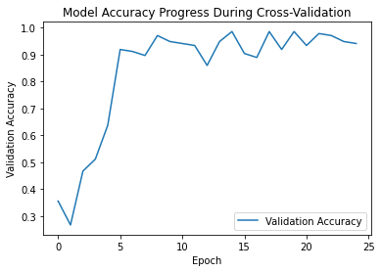
EDA (Exploratory Data Analysis)
Epoch Vs Validation accuracy

Slide 15
Pre-processing Pipeline
Step 1:
We created two folders, Dataset for Training data and Test folder for testing data. Each categories were saved in separate folders with labels as [0, 1, 2]. Label 0 for Sarees, Label 1 for Trousers and Label 2 for Jeans.

Slide 16
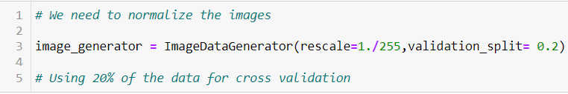
Pre-processing Pipeline
Step 2:
We need to Normalize the images and use 20 % of the data for cross validation(Testing)

Slide 17
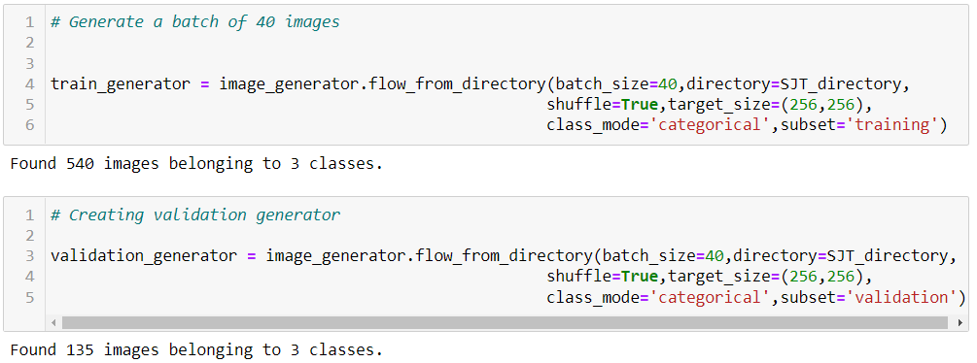
Pre-processing Pipeline
Step3:
We will Generate a batch of 40 images for both Training data and
Validation data.

Slide 18
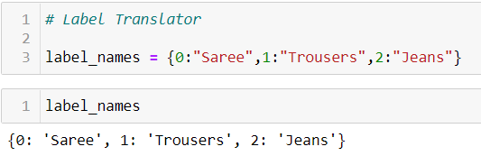
Pre-processing Pipeline
Step 4:
Assigning Label names to images.

Slide 19
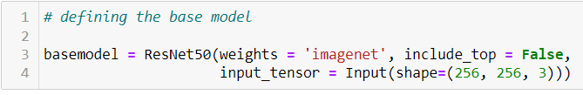
Building Machine Learning Models
Creating a Base-model Importing a model with pre trained weights. Downloading the model.
Image-Net is basically a project aimed at labelling and categorizing images into almost 22,000 categories based on a defined set of words and phrases. We do not include top as we will create our custom input.

Slide 20
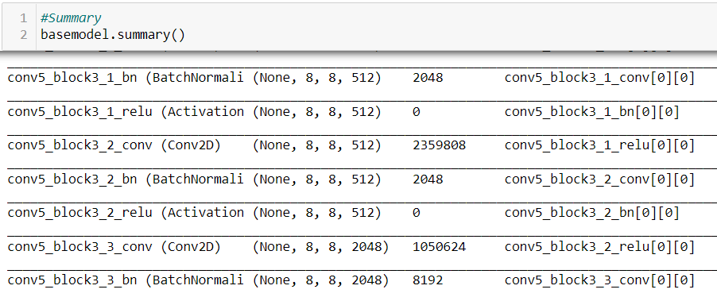
Building Machine Learning Models
Checking Base-model summary. A total of 22 million parameters.

Slide 21
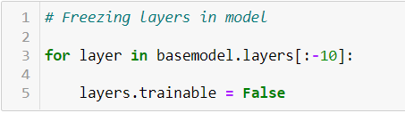
Building Machine Learning Models
Freezing layers as the weights should not be modified after a certain threshold.

Slide 22
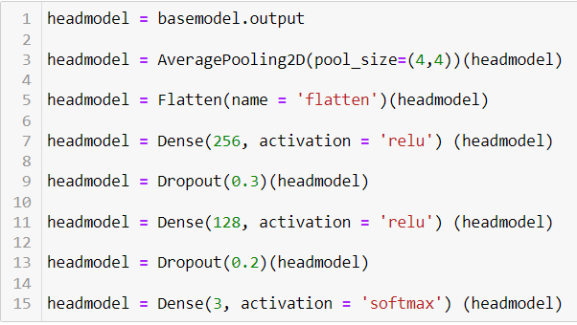
Building Machine Learning Models
Building and Training a deep learning Model.
Now be create a Head model for our Base modelling

Slide 23
Building Machine Learning Models
Adding an Average Pooling layer with size (4 * 4)
Average Pooling is a pooling operation that calculates the average value for patches of a feature map, and uses it to create a down sampled (pooled) feature map. It is usually used after a convolutional layer.
Flattening is converting the data into a 1-dimensional array for inputting it to the next layer. We flatten the output of the convolutional layers to create a single long feature vector.
Dense layer is the regular deeply connected neural network layer. Using Relu activation function
Adding a Dropout layer to drop some neurons both hidden and visible in a neural network.
Adding another Dense layer
Dense layer is the regular deeply connected neural network layer. Using SoftMax activation function as we need to classify three categories.

Slide 24
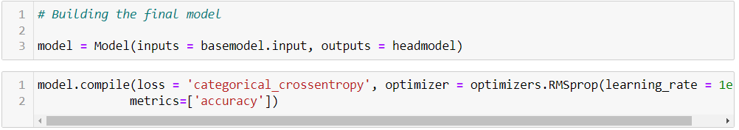
Building Machine Learning Models
Connecting the Head model with the Base Model and compiling it.
Taking evaluation metrics as Accuracy
Taking loss function as categorical cross entropy mostly used for multi class classification problems.

Slide 25
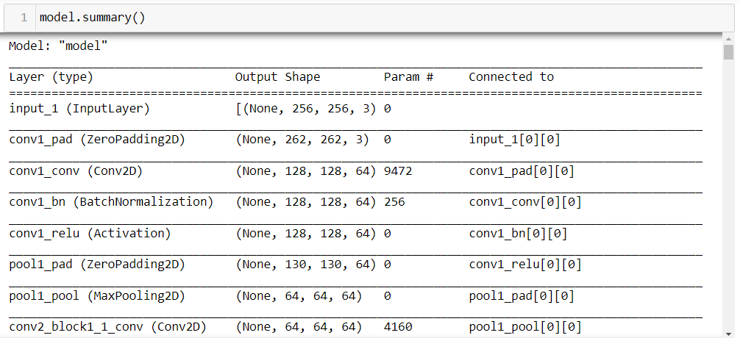
Building Machine Learning Models
Final Model Summary.

Slide 26

Building Machine Learning Models
Using Early Stopping to avoid over fitting problems.

Slide 27
Building Machine Learning Models
Using Model checkpoint to save only the best model.

Slide 28
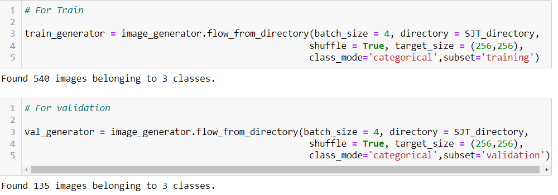
Building Machine Learning Models
Training and Testing Data.

Slide 29
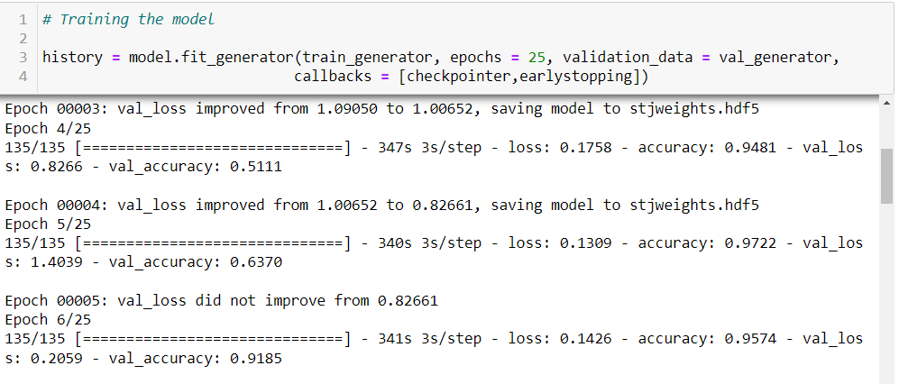
Building Machine Learning Models
Training the model with 25 epochs

Slide 30
Building Machine Learning Models
The best model was saved at epoch number 18
Training Score 0.99%
Validation Score 0.98%

Slide 31
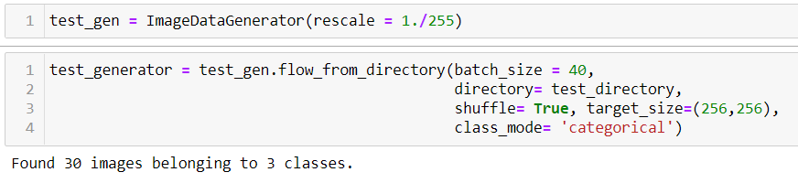
Building Machine Learning Models
Normalizing the test images and creating a batch size of 40 images

Slide 32
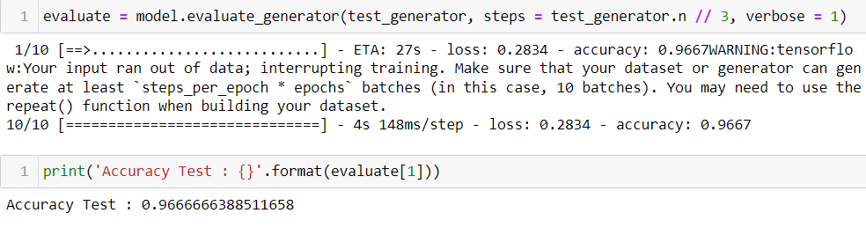
Building Machine Learning Models
Model Accuracy for Test images

Slide 33
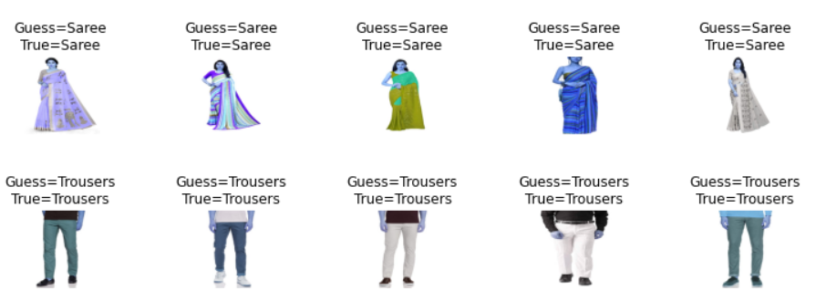
Building Machine Learning Models
Actual Images Vs Prediction

Slide 34
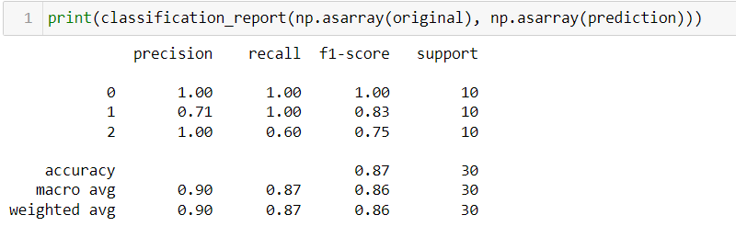
Building Machine Learning Models
Classification Report

Slide 35
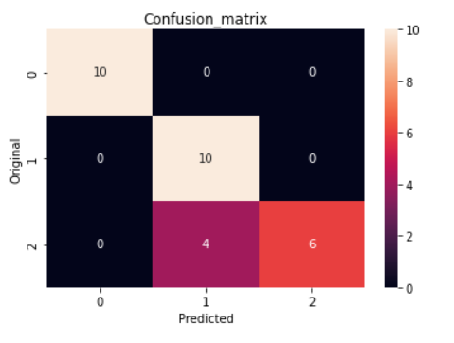
Building Machine Learning Models
Confusion Matrix

Slide 36
Concluding Remarks
Thirty test images including 10 for Sarees (Women),10 images for Trousers (Men) and 10 images for Jeans (Men) were chosen for testing and validation of image classification using deep learning.
The convolutional neural network is used along with REsNet50 CNN with 50 layers and over 22 million pre trained images for classification purpose. From the experiments, it is observed that the images are classified correctly even for the portion of the test images and shows the effectiveness of deep learning algorithm.

